Slide 1

Chapter 2:
Data Visualization
Notes:
‹#›

Slide 2
Objective
Understand the concept and importance of data visualization in the context of data mining.
Explore the goals and benefits of using data visualization techniques.
Learn various techniques for numerical data, including line charts, bar charts, scatter plots, etc.
Understand the techniques specific to non-numerical data, such as pie charts, word clouds, network graphs, etc.
Gain insights into the visualization of dashboards, including the components, design principles, and interactive features.
‹#›

Slide 3
Visualization of Numerical Data
Numerical Data
Numerical data consists of quantitative values that can be measured and represented using numerical scales. Visualizing numerical data helps us understand the distribution, trends, and relationships between numerical variables.
Numerical Data Visualization
Numerical data visualization refers to the graphical representation of quantitative data using charts, graphs, and plots to communicate insights effectively.
Human brains process visual information more efficiently than raw data.
Visualizations help in identifying patterns, trends, and outliers in numerical data, leading to better decision-making.
‹#›

Slide 4
Visualization of Numerical Data
Different Kinds of Visualizations and Their Applications
Line Graphs: Depicting Trends over Time or Ordered Data
  Line graphs connect data points with lines to show trends over time or an ordered variable.
  Representing stock market trends, tracking temperature changes, showing population growth.
‹#›

Slide 5
Visualization of Numerical Data
Different Kinds of Visualizations and Their Applications
Bar Charts: Displaying Categorical Data with Rectangles
  Bar charts use rectangular bars to compare categorical data.
  Visualizing survey results, comparing sales of different products, displaying frequency distributions.
‹#›

Slide 6
Visualization of Numerical Data
Different Kinds of Visualizations and Their Applications
Scatter Plots: Visualizing the Relationship between Two Variables
  Scatter plots use data points to display the relationship between two numerical variables.
  Assessing correlation between variables, identifying clusters or trends, detecting outliers.
‹#›

Slide 7
Visualization of Numerical Data
Choosing the Right Visualization for Your Data
Factors Influencing Visualization Selection:
  Nature of data (categorical, ordinal, numerical): Different data types require specific visualizations.
  Data distribution and granularity: Data distribution impacts the choice of visualization.
Guidelines for Matching Data Types with Visualizations:
  Decision tree for choosing appropriate visualizations: A step-by-step guide for selecting the right chart type.
  Examples of correct and incorrect visualization choices: Illustrations to reinforce the concept.
‹#›

Slide 8
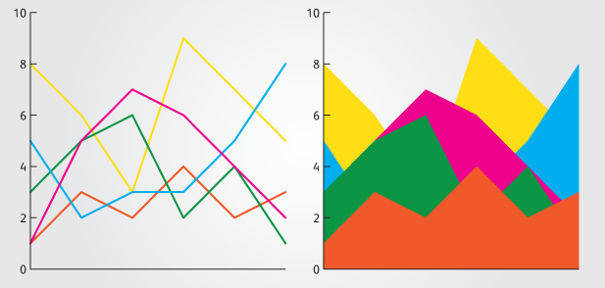
Visualization of Numerical Data
Line Charts and Area Charts
Line charts display data points connected by lines, representing the trend or change in a variable over time or another continuous dimension.
Area charts are similar to line charts but filled with colors or patterns below the line, representing the cumulative values of the variable.
[Credit: https://www.fusioncharts.com/ ]
‹#›

Slide 9
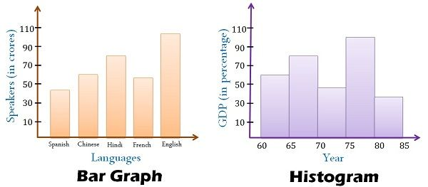
Visualization of Numerical Data
Bar Charts and Histograms
Bar charts use rectangular bars of varying lengths or heights to represent the values of different categories or groups. They are useful for comparing discrete or categorical data.
Histograms display the distribution of continuous data by dividing it into bins or intervals and representing the frequency or count of data points within each bin as vertical bars.
[Credit: https://www.fusioncharts.com/ ]
‹#›

Slide 10
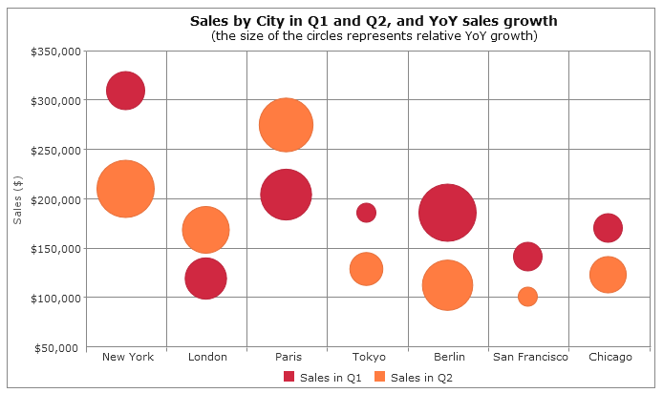
Visualization of Numerical Data
Scatter Plots and Bubble Charts
Scatter plots show the relationship between two numerical variables. Each data point is plotted as a point on the graph, with one variable on the x-axis and the other on the y-axis.
Bubble charts are an extension of scatter plots where an additional numerical variable is represented by the size or color of the data points, adding another dimension to the visualization.
[Credit: https://www.fusioncharts.com/ ]
‹#›

Slide 11
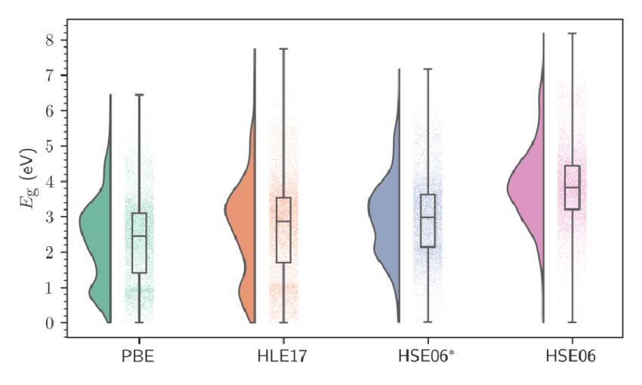
Visualization of Numerical Data
Box Plots and Violin Plots
Box plots (also known as box-and-whisker plots) display the summary statistics of a numerical variable, including the minimum, maximum, median, quartiles, and outliers. They provide insights into the distribution and skewness of the data.
Violin plots combine a box plot with a kernel density plot, providing a more detailed view of the distribution and density of the data.
‹#›
[Credit: https://www.fusioncharts.com/ ]

Slide 12
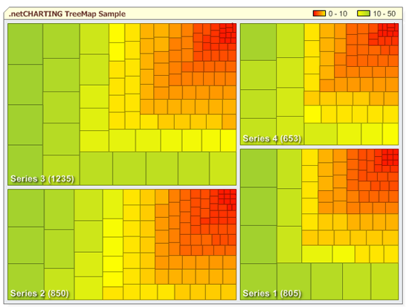
Visualization of Numerical Data
Heatmaps and Treemaps
Heatmaps use color-coded cells in a grid to represent the values of a numerical variable across two dimensions. They are effective for visualizing large datasets and identifying patterns or correlations.
Treemaps represent hierarchical data as nested rectangles, with the size of each rectangle proportional to a numerical value. They are useful for displaying hierarchical relationships and comparing proportions.
[Credit: https://www.fusioncharts.com/ ]
‹#›

Slide 13

Visualization of Numerical Data
Elements of Design and Color Usage
Importance of Design Principles in Data Visualization:
  Emphasizing clarity, simplicity, and consistency: Addressing the significance of design in data visualization.
  Well-designed vs. poorly designed visualizations
[Credit: https://www.fusioncharts.com/ ]
‹#›

Slide 14
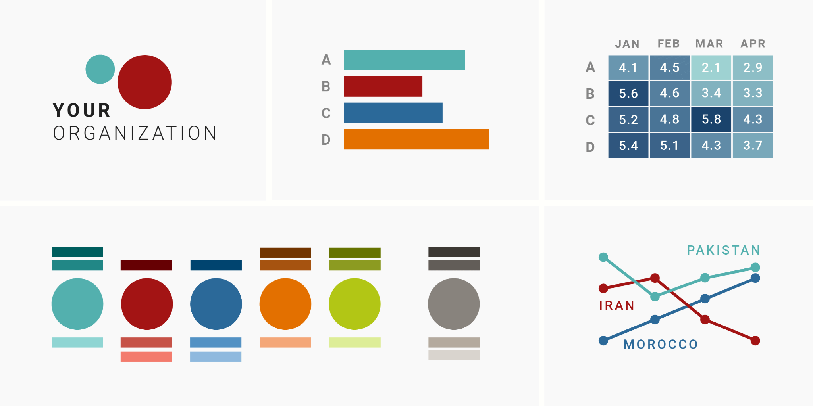
Visualization of Numerical Data
Elements of Design and Color Usage
Choosing the Right Color Palettes for Numerical Data:
  Addressing potential color blindness issues: Ensuring accessibility and inclusivity.
  Examples of color palettes suitable for numerical data
[Credit: https://www.fusioncharts.com/ ]
‹#›

Slide 15
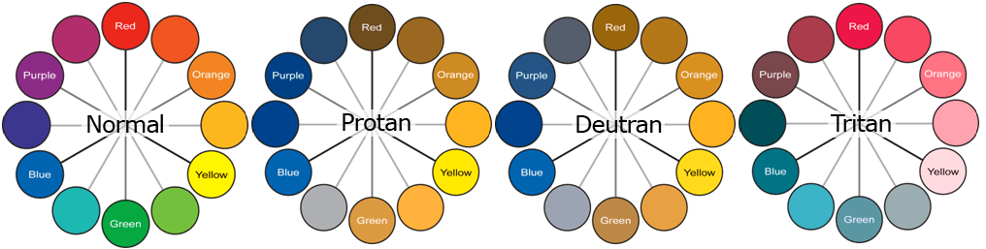
Visualization of Numerical Data
Elements of Design and Color Usage
Color Blindness Considerations and Accessibility:
  Designing visualizations accessible to color-blind users: Applying best practices for inclusive design.
  Visual examples of visualizations with and without color blindness considerations
[Credit: https://www.fusioncharts.com/ ]
‹#›

Slide 16
Visualization of Numerical Data
Best Practices for Visualizing Numerical Data
Choose the appropriate visualization technique based on the nature of the data and the insights you want to convey.
Ensure clear labeling of axes, titles, and legends to provide context and aid interpretation.
Use appropriate scales and axes ranges to avoid distorting the data or misleading the viewer.
Apply color and visual cues thoughtfully to highlight patterns, trends, or specific data points.
Consider adding interactivity, such as zooming or filtering, to allow users to explore the data in more detail.
‹#›

Slide 17
Summary
Visualization of Numerical Data
Techniques for Numerical Data:
- Learn diverse visualization techniques.
- Examples include line charts, bar charts, scatter plots, etc.
‹#›

